Slide 1
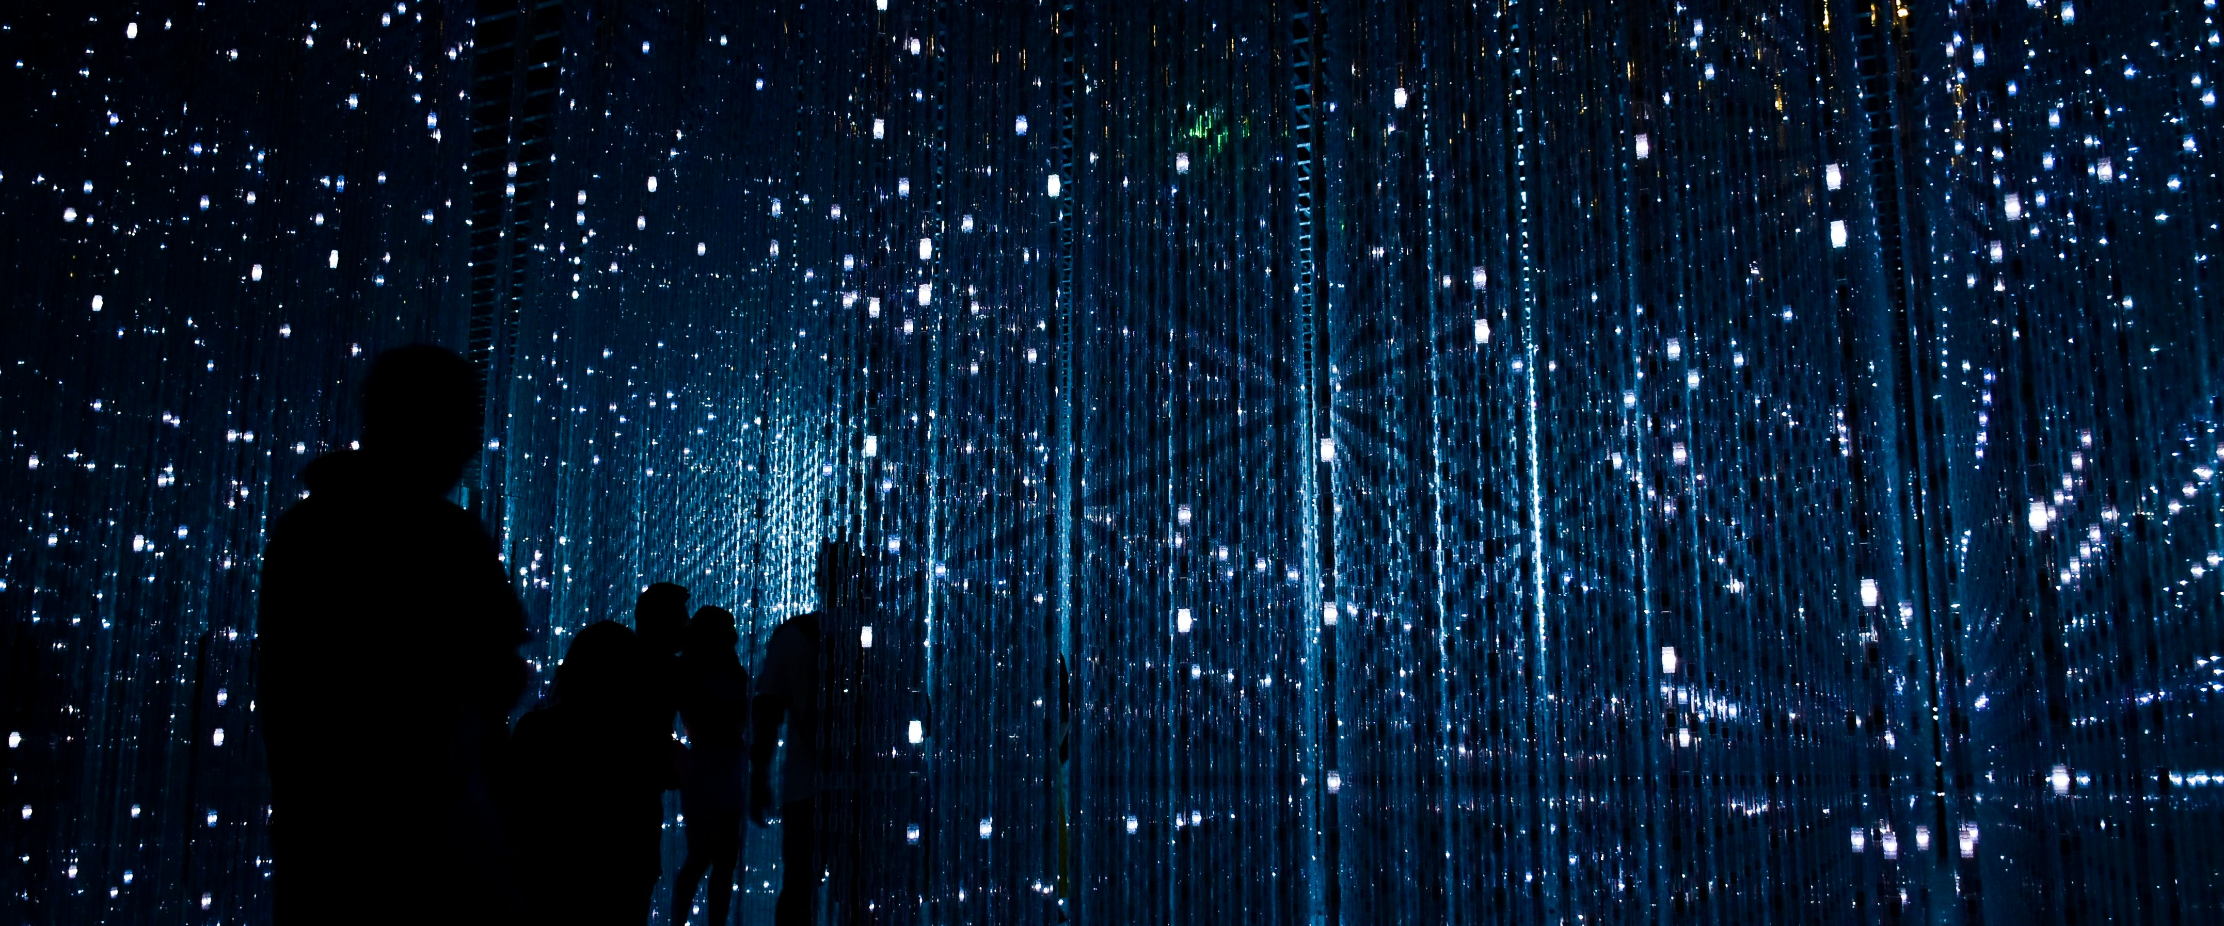
Project Black Sky: Watching the Watchers
Suspicious skies, revealed.

Slide 2
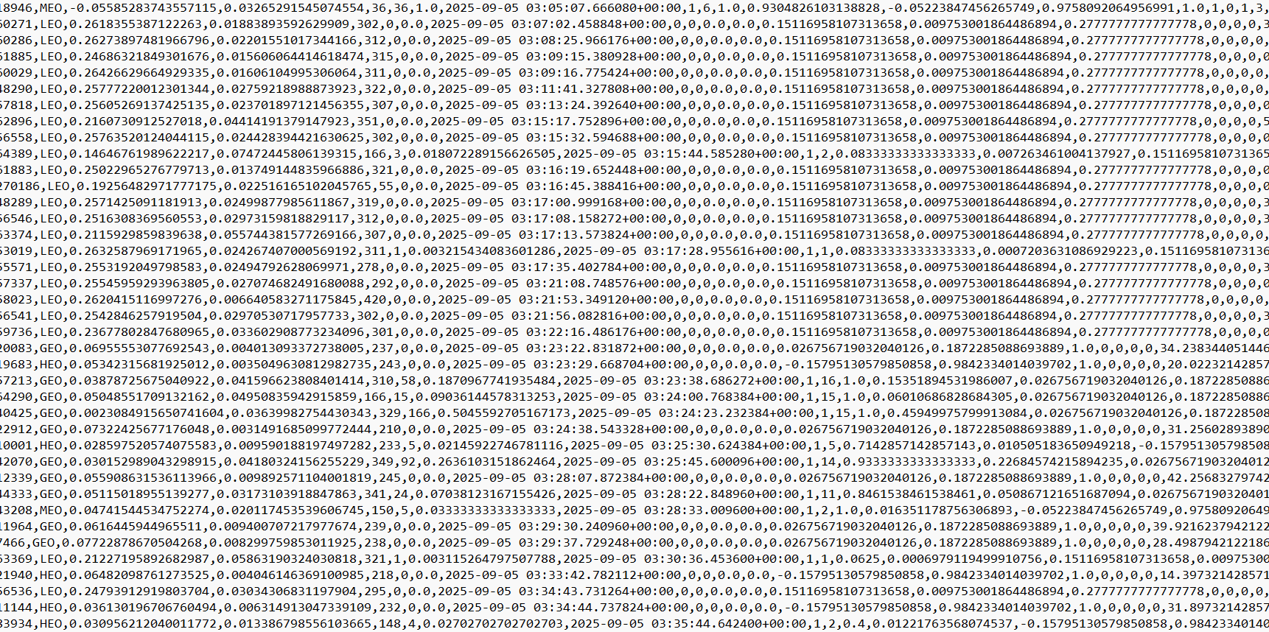
anomalous_rows.csv
scores.csv
dailies.csv

Slide 3
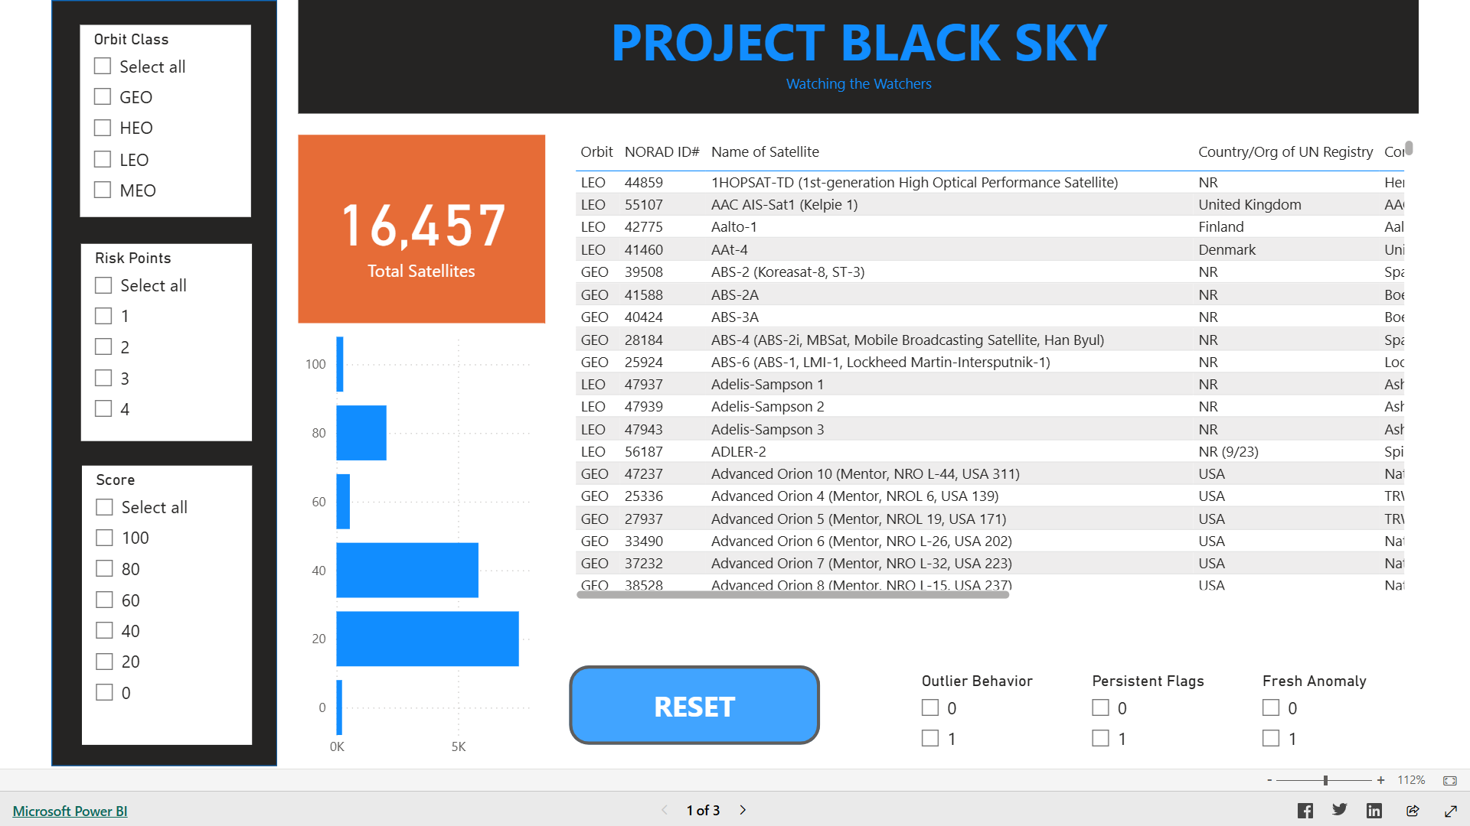

Slide 4
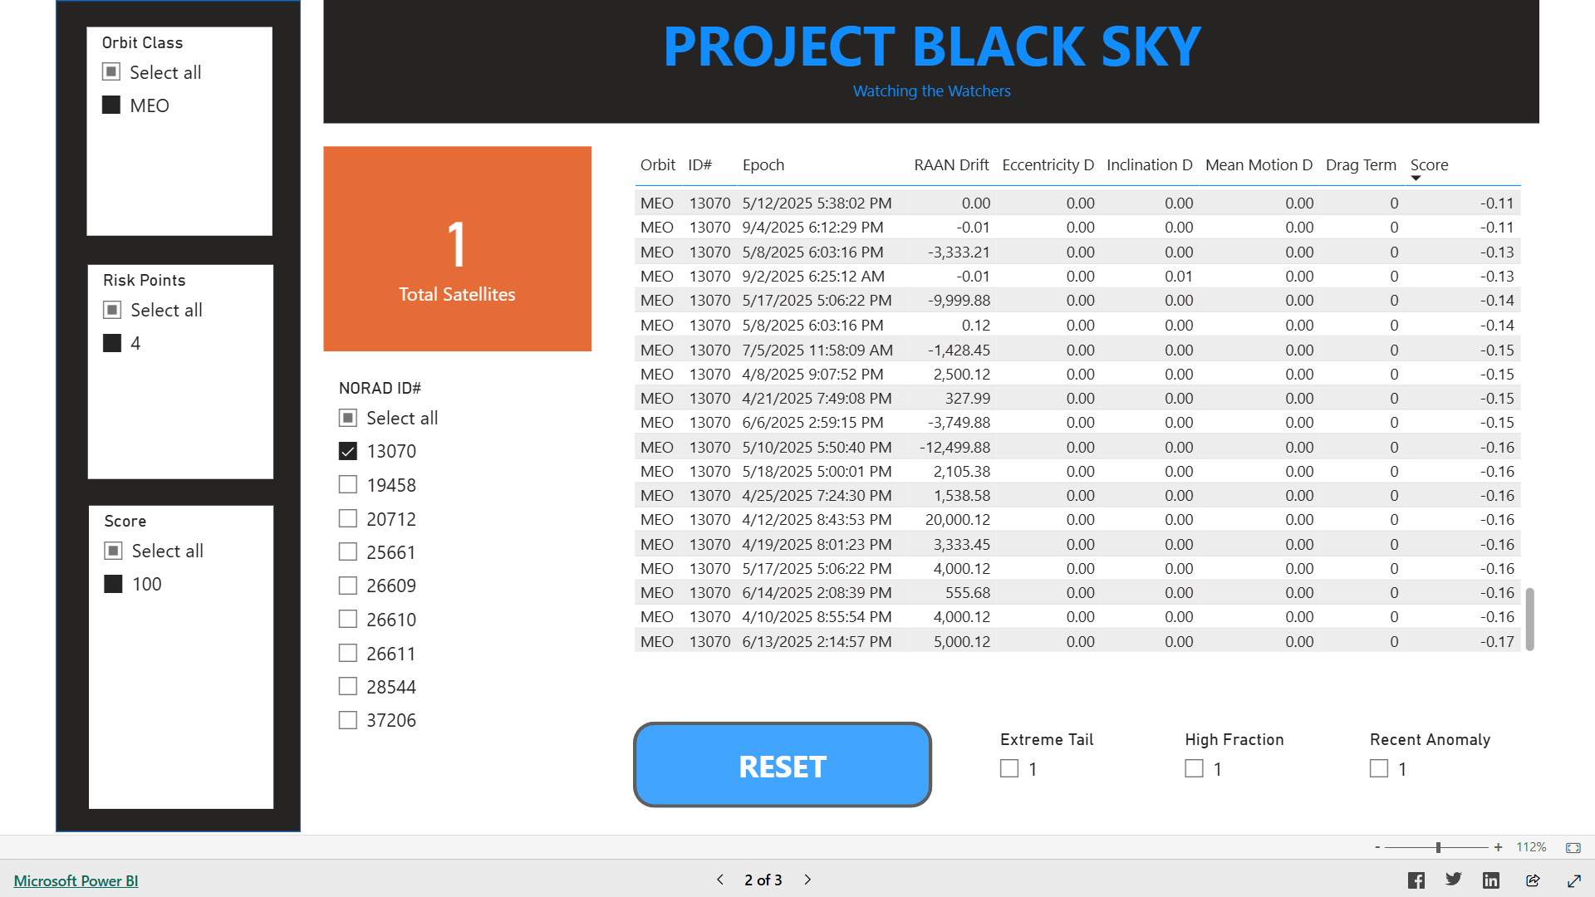

Slide 5
